Slide 1

University of New Haven
Customer Segmentation
and Churn Analysis for ISPs
Midterm Project Pitch Deck: Team 6
Distributed and Scalable Data Engineering

Slide 2
Team Members
Uday Shankar
Team Member
Kavyasree Moktala
Team Member
Radiah Zaman Sarin
Team Member
Venu Gopal Reddy
Team Leader

Slide 3

Introduction
Customer segmentation is an effective tool for businesses to closely align their strategy and tactics with, and better target, their current and future customers. Every customer is different, and every customer journey is different. So, a single approach often isn’t going to work for all.

Slide 4
WHAT MAKES CUSTOMERS LOOK FOR A BETTER SERVICE PROVIDER
Poor Quality Service
Poor Customer Support
Cheaper alternatives
Limited plan options

Slide 5
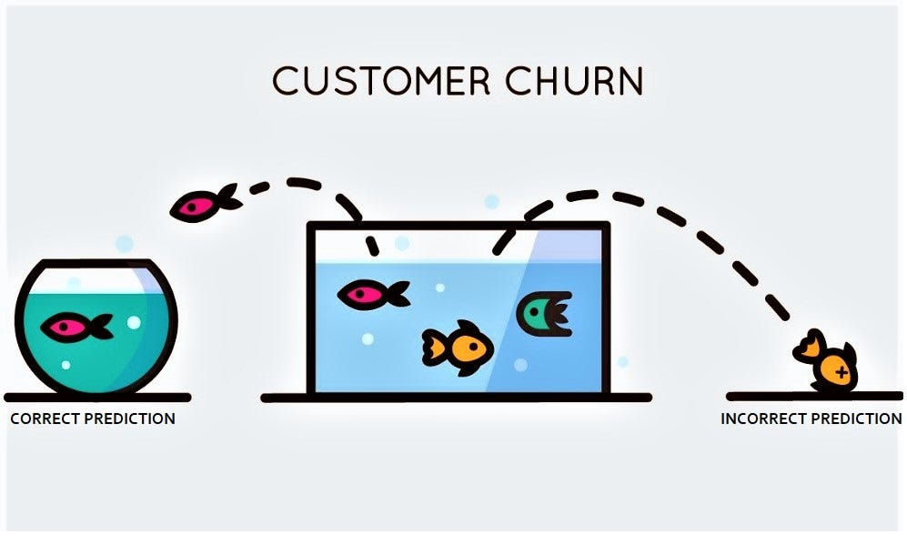
CUSTOMER CHURN ANALYSIS
Customer churn, also known as customer attrition, is when someone chooses to stop using your products or services. In effect, it’s when a customer ceases to be a customer. Customer churn is measured using customer churn rate. That’s the number of people who stopped being customers during a set period of time, such as a year, a month, or a financial quarter. Churn analysis is the evaluation of a company's customer loss rate in order to reduce it. Also referred to as customer attrition rate, churn can be minimized by assessing your product and how people use it

Slide 6

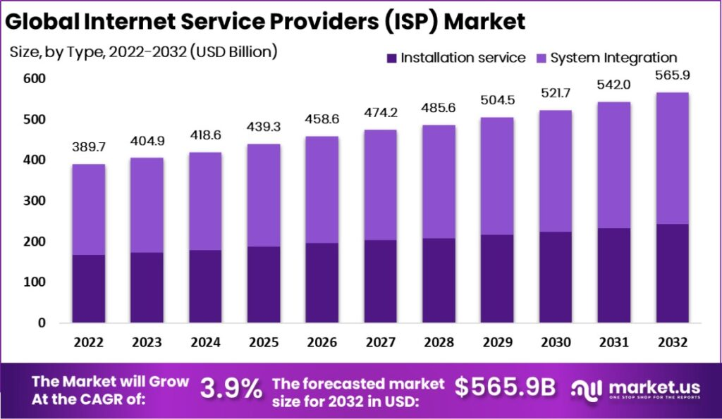
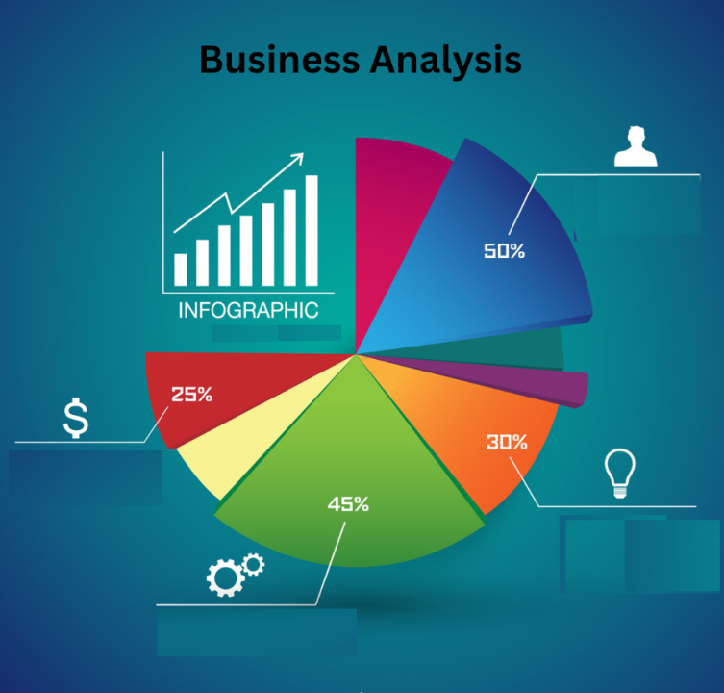

Slide 7

High-Risk Segments
Competitor Comparison
Churn Analysis
What is the current churn rate for the ISP?
Can we identify patterns or trends in customer churn over the past quarters or years?
Which customer segments are at the highest risk of churning?
What are the common characteristics of customers who have recently churned?
How do our churn rates compare to competitors in the industry?
Are there lessons or strategies we can learn from successful competitors?

Slide 8


Improved Customer Support
Implement systems for early issue detection and proactive resolution.
Competitive Pricing and Promotions:
Assess and adjust pricing models to remain competitive.
Technological Upgrades
Upgrade infrastructure and services to align with technological advancements.
Enhanced Customer Engagement
Implement targeted communication strategies for high-risk segments.

Slide 9
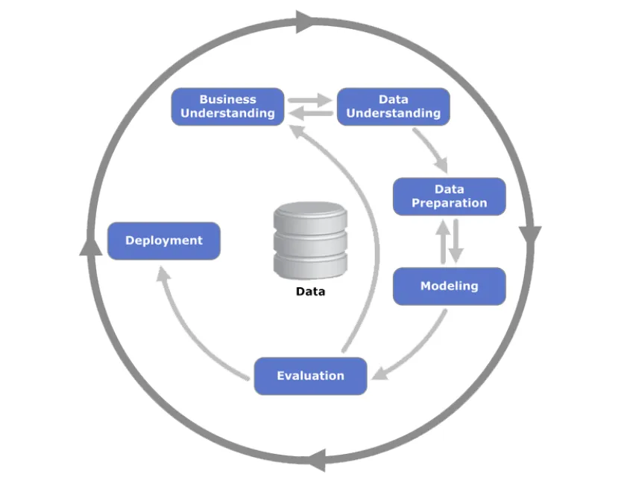
OUR PLAN
CRISP-ML
Business Understanding
Data Collection and Integration
Data Cleaning and Preparation
Data Modeling and Analysis
Deployment

Slide 10
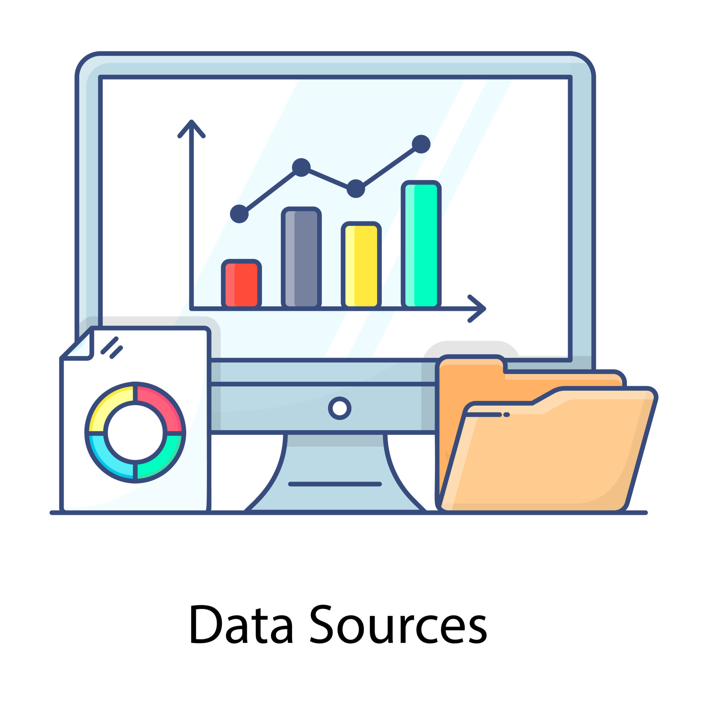
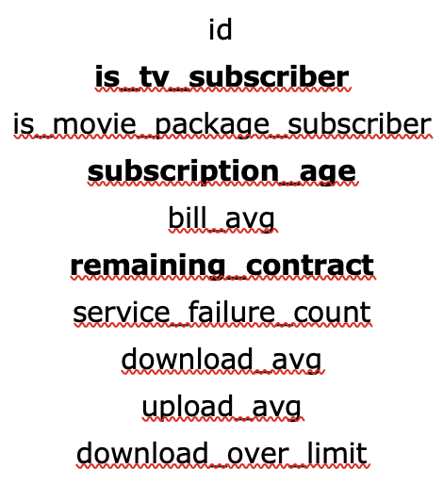
DATA SOURCES
Internet Service Provider churn data
Internet Service Provider speeds and prices
Source: https://www.kaggle.com/datasets/mehmetsabrikunt/internet-service-churn https://www.kaggle.com/datasets/michaelbryantds/internet-speeds-and-prices

Slide 11
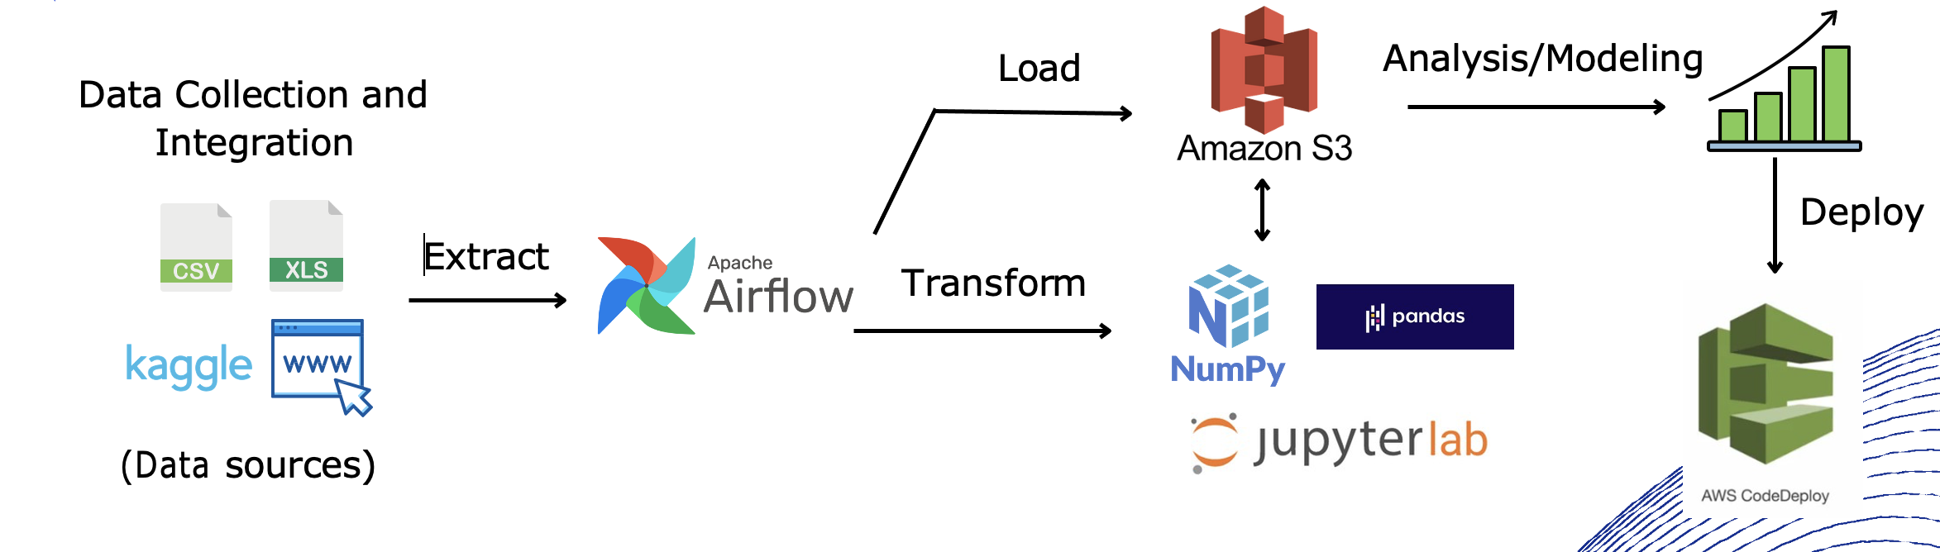
Technology/expertise

Slide 12


Why we are better ?
Some key points are :
Accurate Churn Prediction: Our project employs advanced machine learning techniques to accurately predict customer churn, enabling ISPs to proactively identify and retain at-risk customers before they churn.
Customizable Segmentation: We offer customizable segmentation methods tailored to the specific needs of ISPs, allowing them to categorize customers based on various criteria such as usage patterns, demographics, and service preferences, leading to targeted retention strategies.
Scalability and Efficiency: Designed with scalability in mind, our project can handle large volumes of customer data efficiently, ensuring smooth operations for ISPs of all sizes. Its efficient processing capabilities enable timely analysis and decision-making, enhancing overall effectiveness in churn reduction efforts.

Slide 13
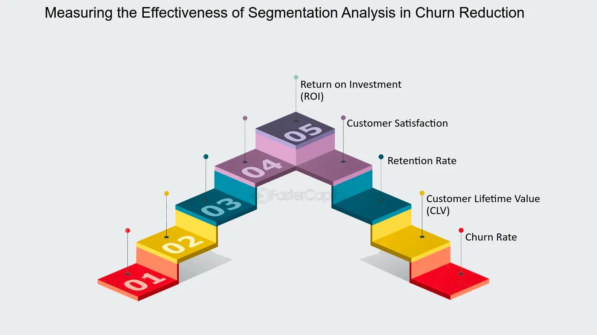

Slide 14
Road Map
Phase 1: Data Collection and Exploration
Gather customer data from CRM, billing systems, and surveys. Clean and preprocess data, conduct exploratory analysis.
Phase 2: Segmentation and Modeling
Segment customers based on demographics and usage patterns. Develop churn prediction models using machine learning.
Phase 3: Visualization on dashboard
Analyze customer behavior Track customer satisfaction. Churn probability

Slide 15
THANK YOU

